Slide 1
CO –PO Management Portal
Hariharan R
2019272010
Project Guide
Ms. S. Kanimozhi

Slide 2
MOTIVATION & OBJECTIVE
The goal of this project is to determine whether or not the course and programme outcomes were met. The user gains clarity by visualising the Co and Po data.
To improve the Co and Po mapping into a digitalized version, there are some mapping types already available, such as excel, but the data will be lost in some cases, and we won't be able to track data from previous years, so we wanted to develop a web platform that will store data in the cloud and allow us to view the history of records.

Slide 3
INTRODUCTION
Accreditation allows the institute to better understand its own strengths, shortcomings, and potential. It assists the institute in accepting creative and modern approaches for the institute's improvement.
The attainment of course and programme outcomes is one of the major criteria used by the National Board of Accreditation.
NBA expects that a student's performance and knowledge will be evaluated based on the evaluation and attainment obtained from course and programme results.

Slide 4
LITERATURE REVIEW
S.No | Author name & Paper title | Concept in the paper (Algorithm, Advantages, Limitations, Future enhancement) | Paper details
1 | Comparative analysis of MEAN stack and MERN stack | Advantages and disadvantages analysis between MEAN vs MERN stack | https://www.jetir.org/papers/JETIR2105881.pdf
2 | Author: Mehul Kothari | Authentication Using JWT in MEAN Stack for securely transmitting information | https://itnext.io/authentication-using-jwt-in-mean-stack-6b425247b7d8
3 | Author: Michelle Selzer | Salt and Hash Passwords with bcrypt | https://heynode.com/blog/2020-04/salt-and-hash-passwords-bcrypt/

Slide 5
DATASET DETAILS
For Co Po Dataset we referred this link: https://drive.google.com/file/d/1hFTf4atswmJuTYR_3X10Z1g__TLFAltS/view?usp=sharing

Slide 6
IMPLEMENTATION PLATFORM / FRAMEWORK
MEAN Stack
M : MongoDB Atlas
E : Express,
A : Angular,
N : Node,
4 key technologies that make up the layers of the stack.
VS Code editor which helps for developer interaction with its supporting features.

Slide 7
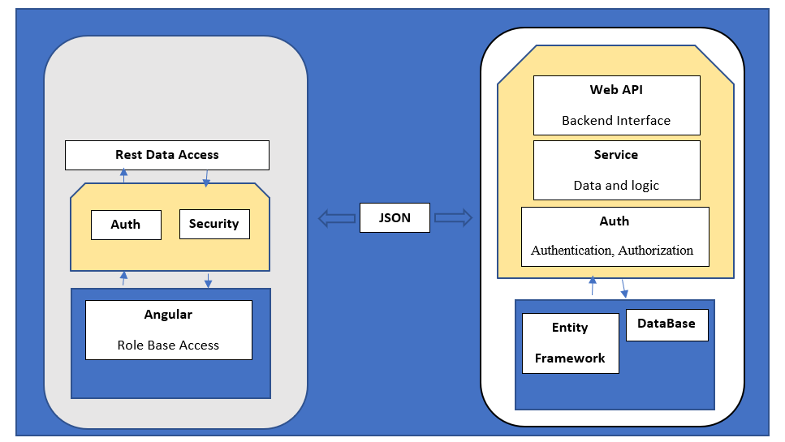
OVERALL ARCHITECTURE

Slide 8
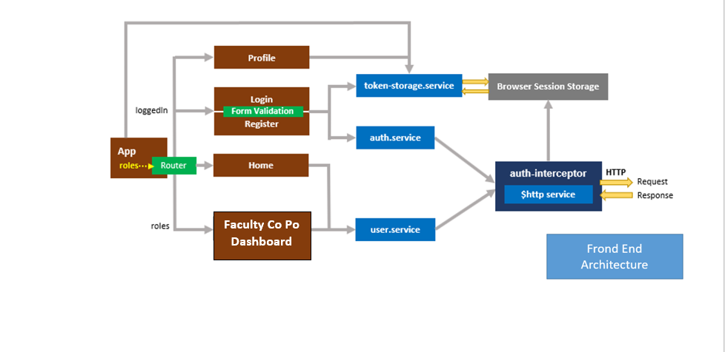
Frond End ARCHITECTURE

Slide 9
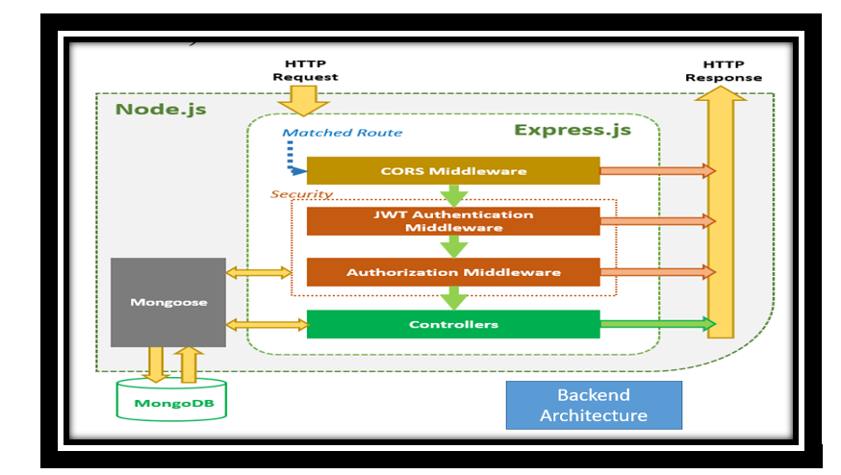
Back End ARCHITECTURE

Slide 10
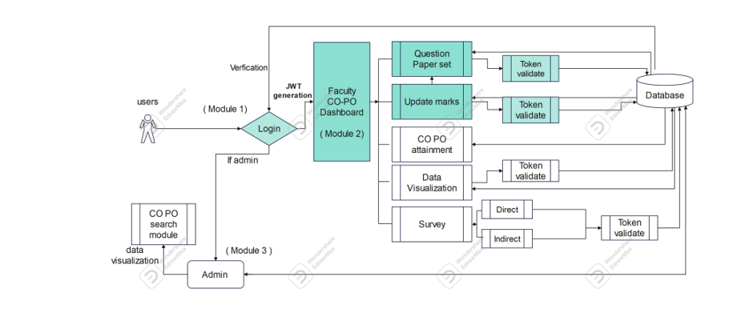
Block Diagram

Slide 11
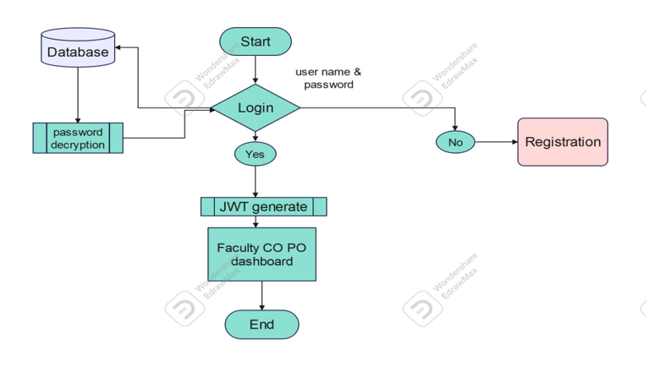
Flow Diagram for Login

Slide 12
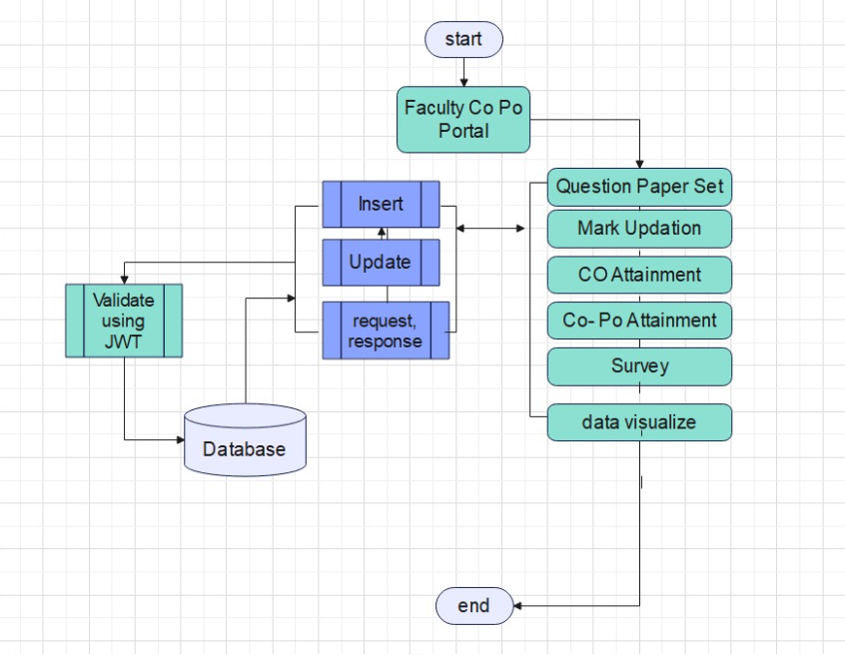
Flow Diagram Co and Po Dashboard

Slide 13
LIST OF MODULES
Login Module
Admin Dashboard
Faculty Co Po Dashboard
Question Paper Set Module
Update Marks Module
CO Attainment Module
Co – Po Attainment Module
Data Visualizing
Survey module
Direct Method
Indirect Method

Slide 14
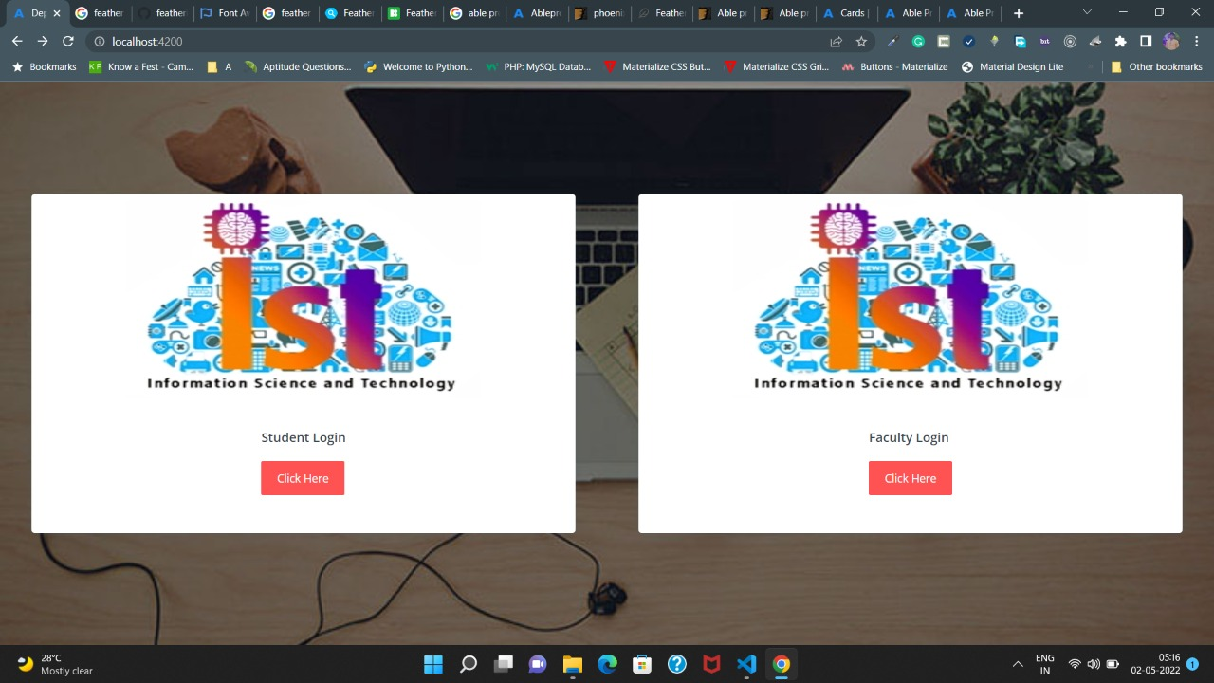

Slide 15
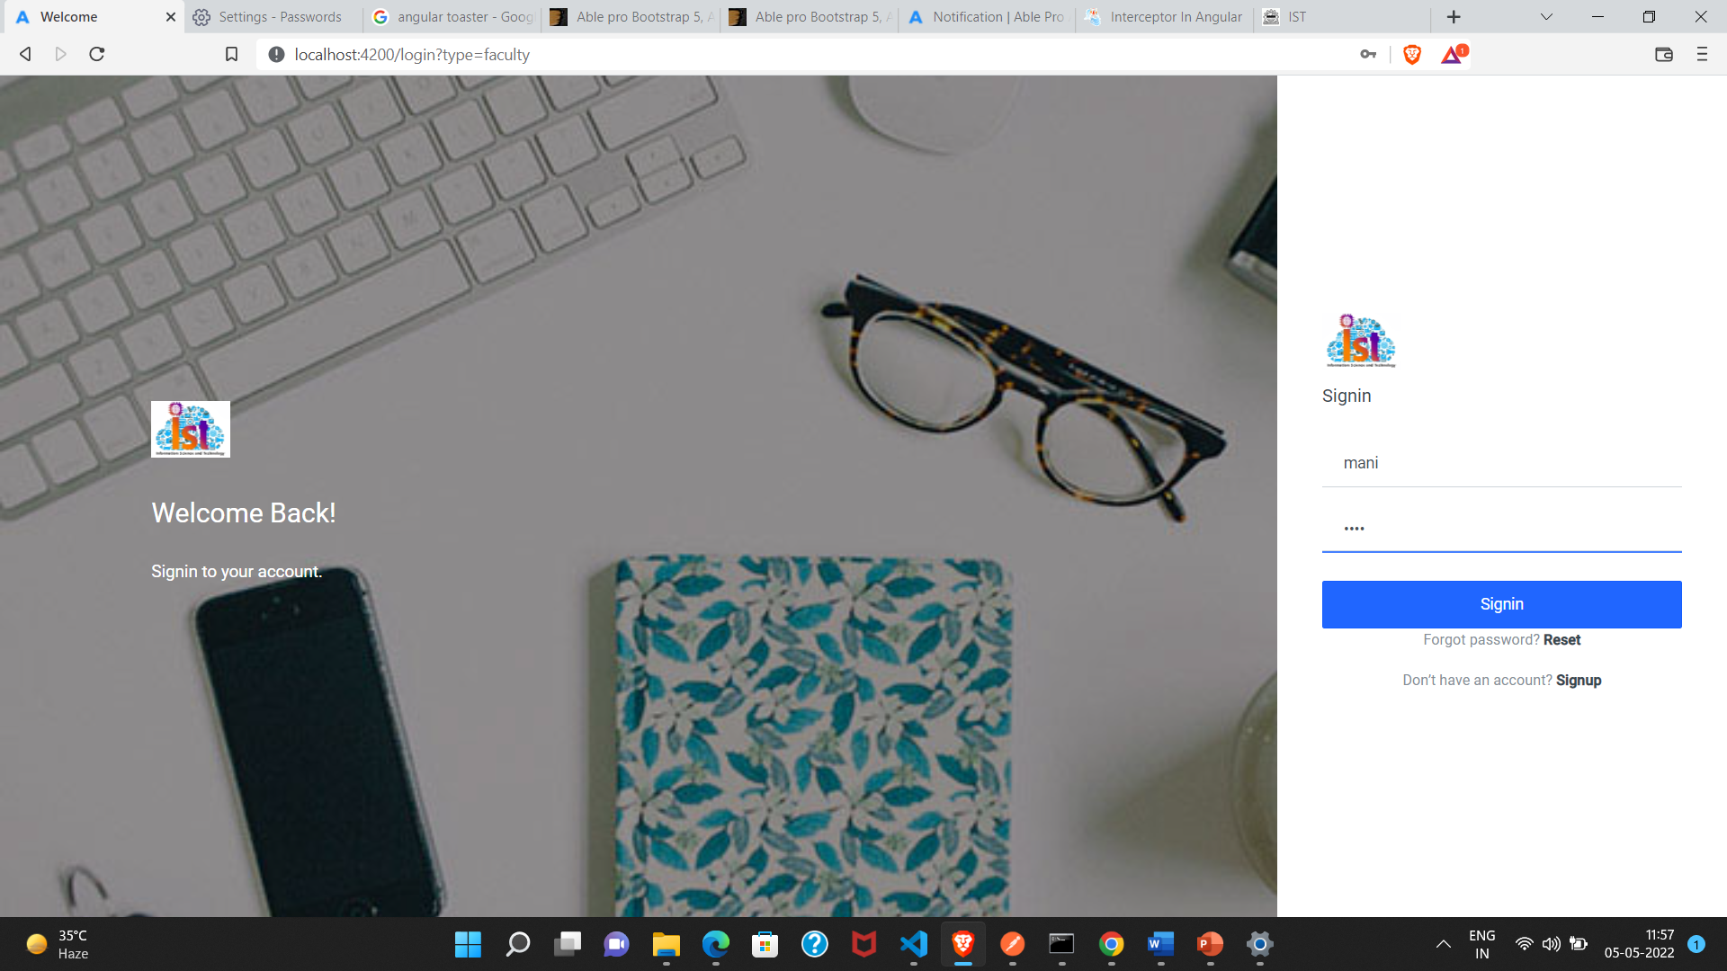

Slide 16
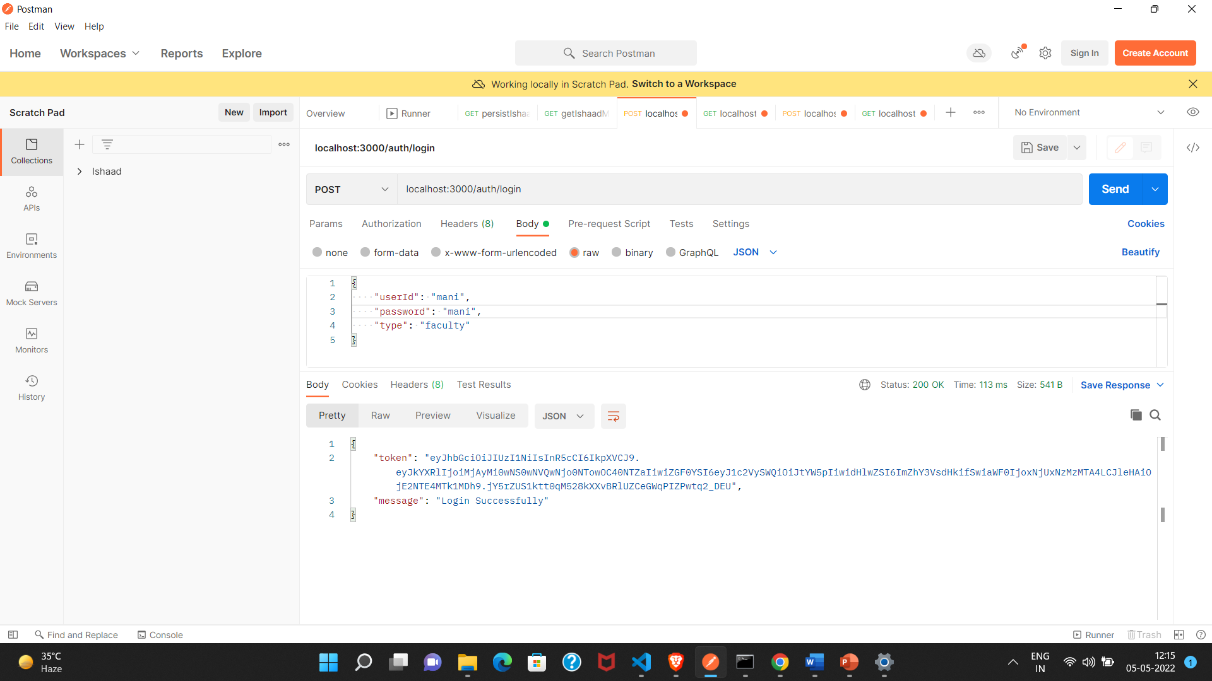
Post Man Testing

Slide 17
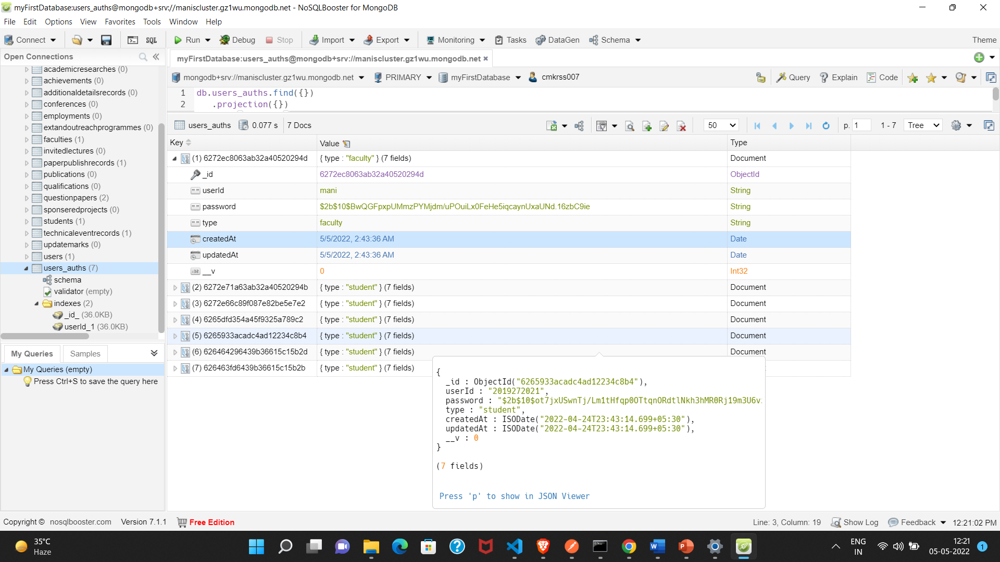
Data Base Testing

Slide 18
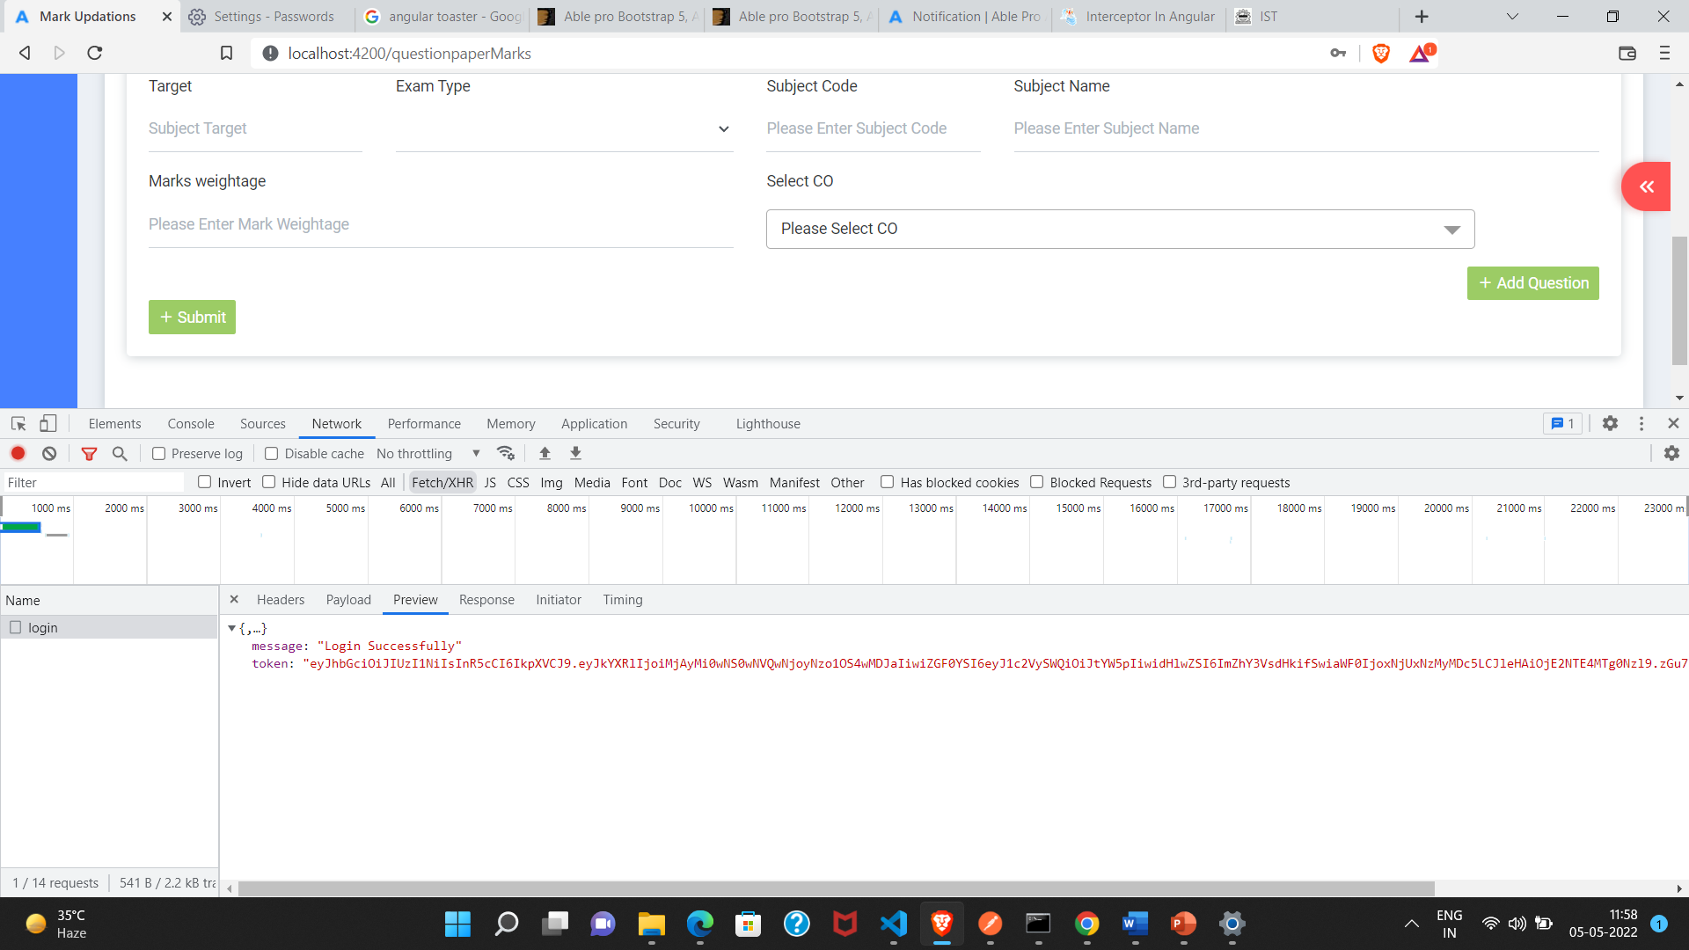
UI Testing

Slide 19
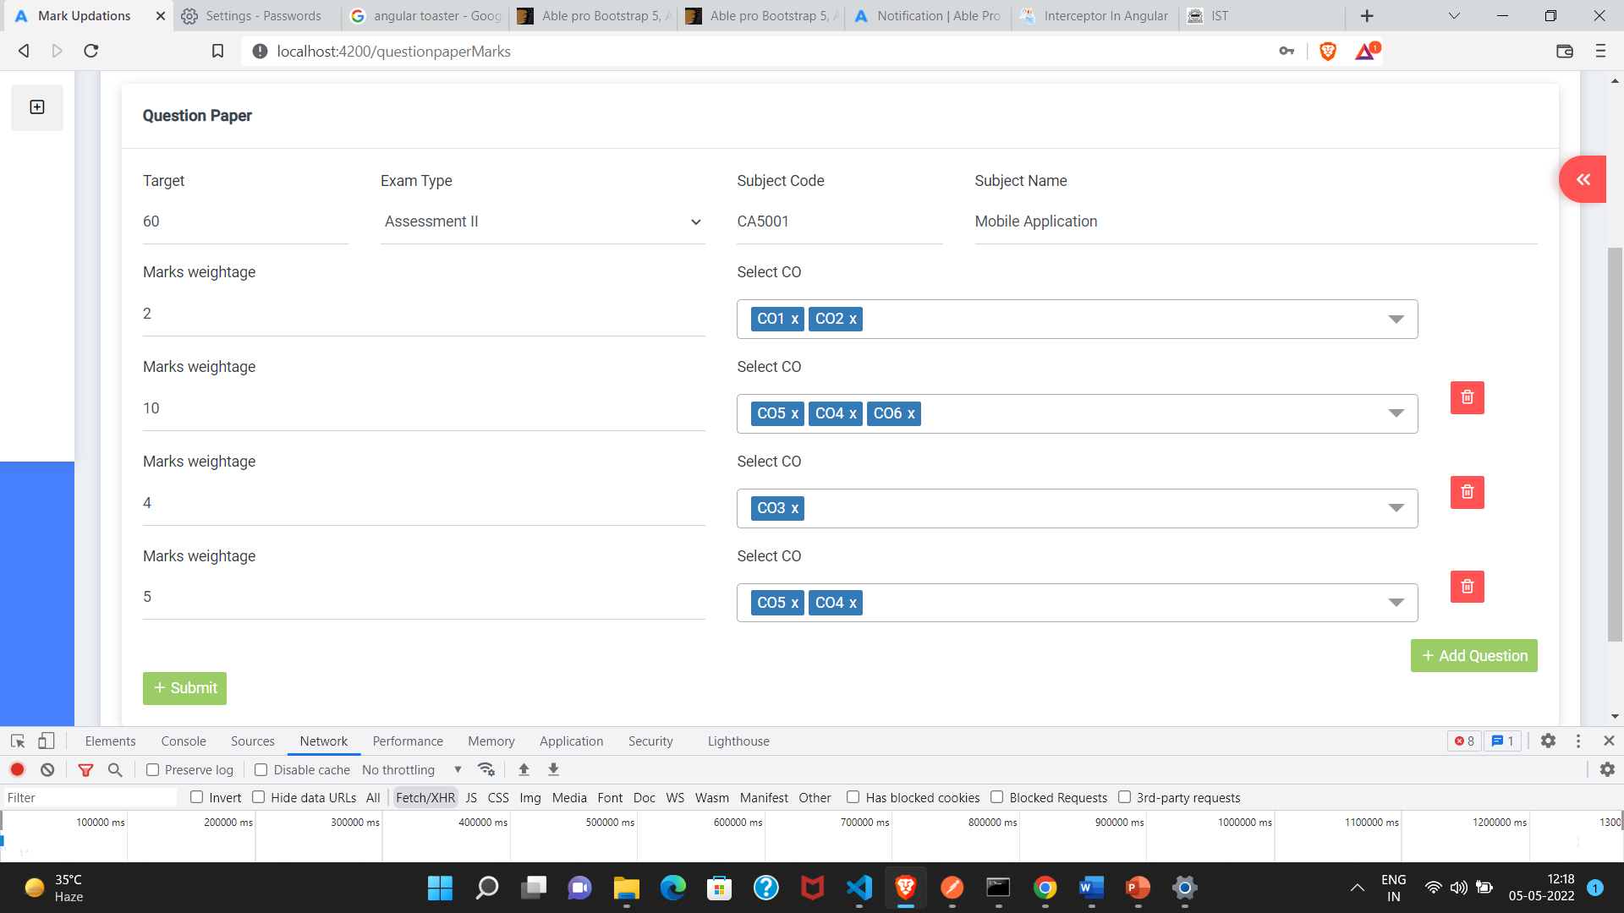
Question Paper Set

Slide 20
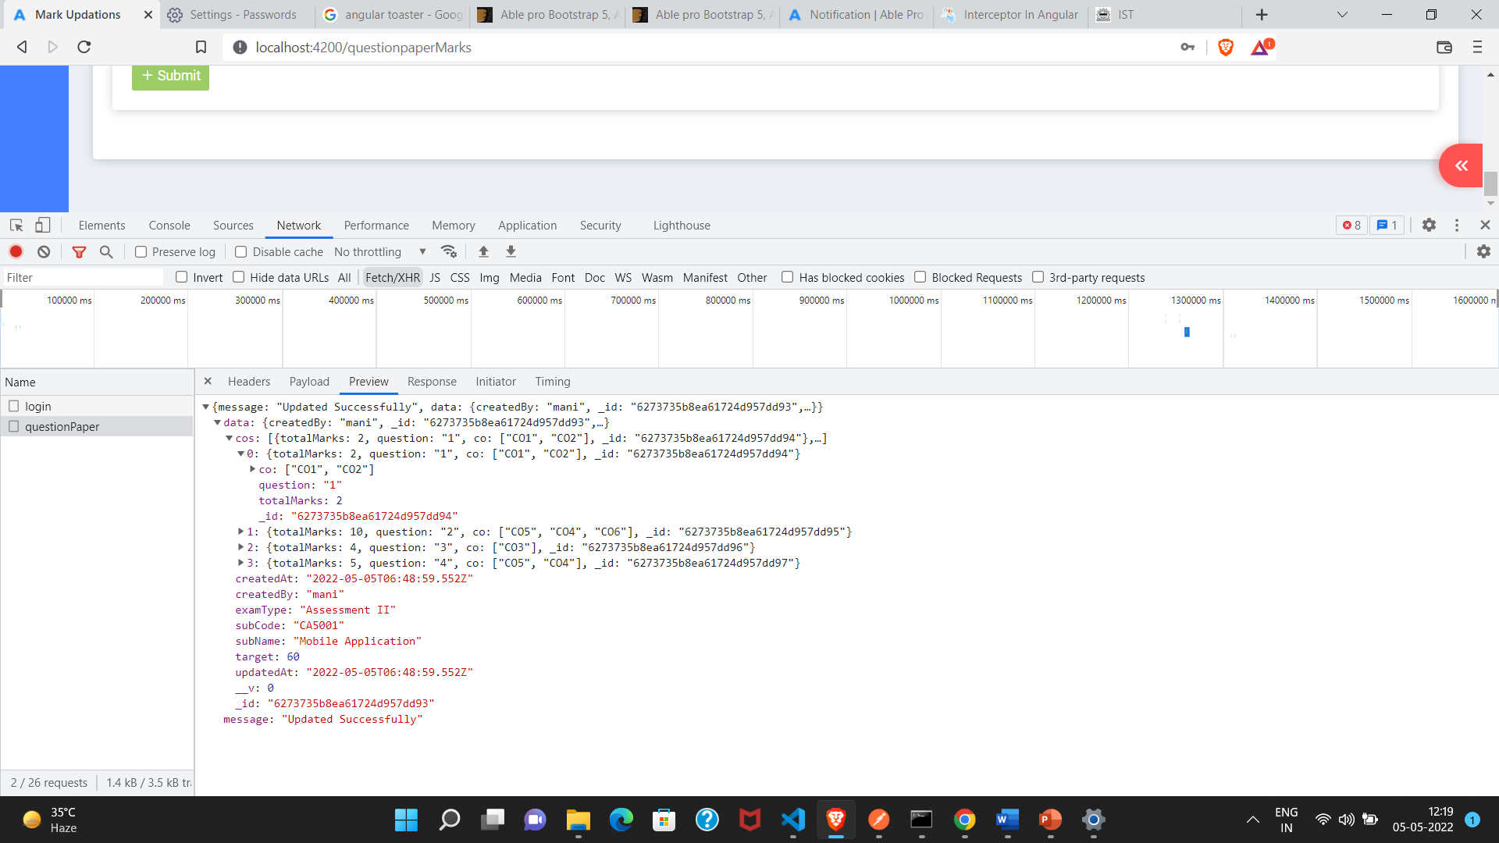

Slide 21
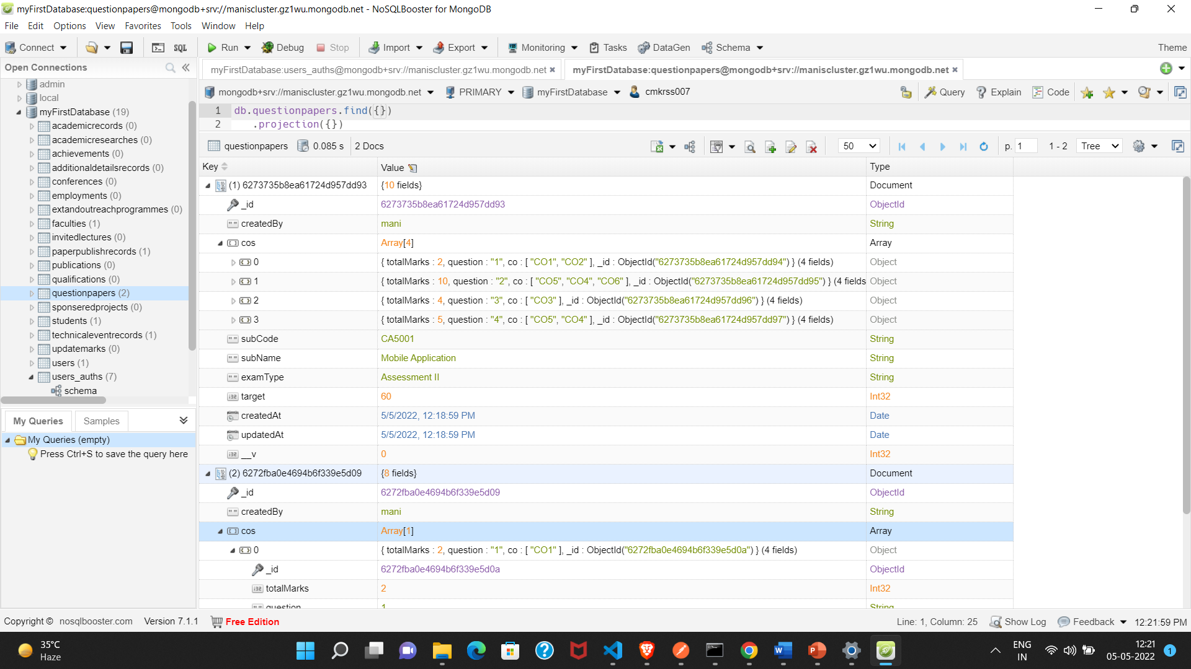
Database Testing

Slide 22
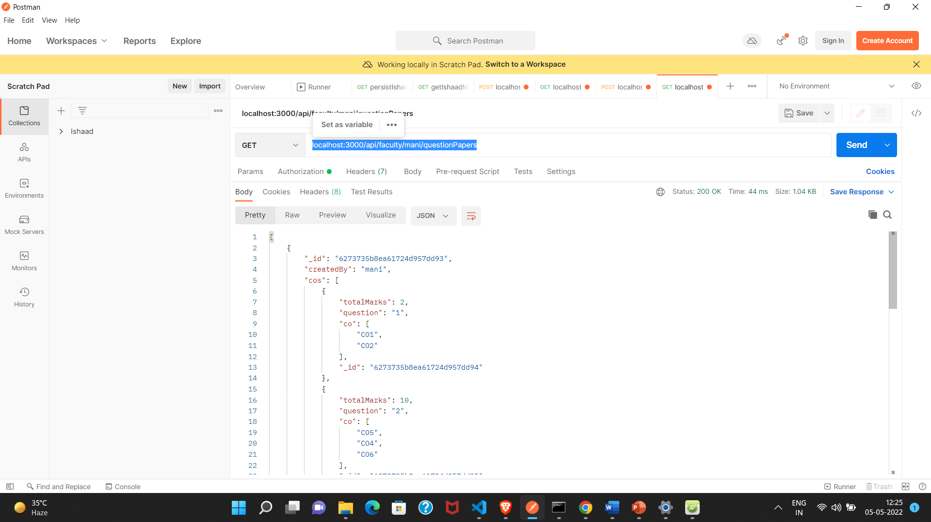
Post Man testing Api Endpoint to retrive question paper http://localhost:3000/api/faculty/mani/questionPapers

Slide 23
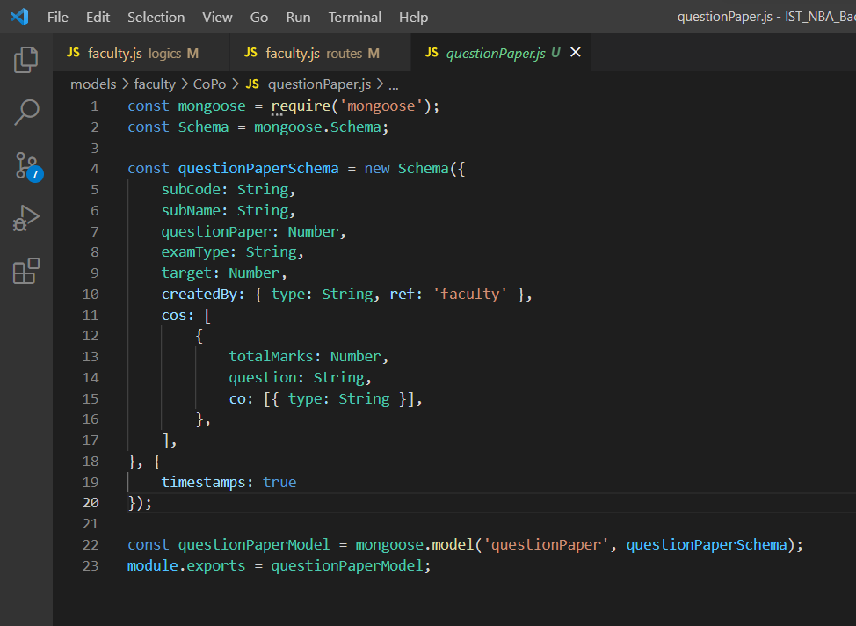
Module Base Code Screen Shot

Slide 24
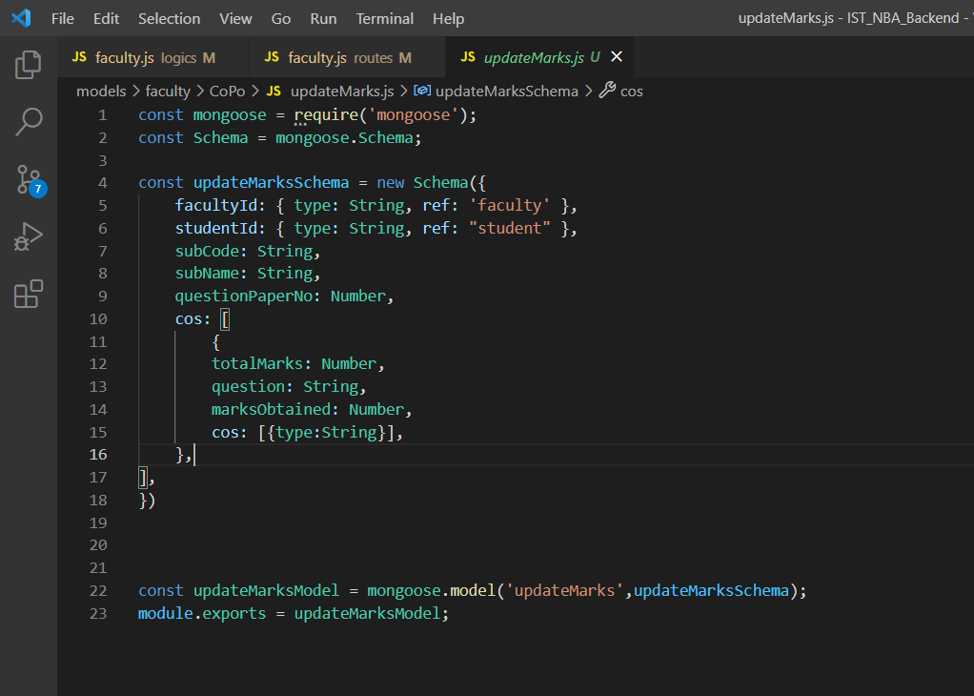

Slide 25
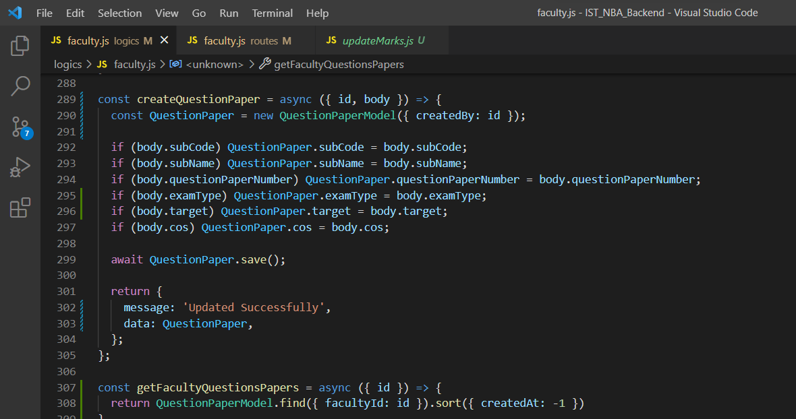

Slide 26
REFERENCES
MEAN Stack reference
https://www.researchgate.net/publication/322821888_Simplifying_Web_Application_Development_Using-Mean_Stack_Technologies
Secure transmitting information
https://itnext.io/authentication-using-jwt-in-mean-stack-6b425247b7d8
password hashing:
https://www.loginradius.com/blog/engineering/hashing-user-passwords-using-bcryptjs/

Slide 27
THANK YOU

